Slide 1

Task - 3

Slide 2
Introduction
The site of acunetix acuform url: http://testasp.vulnweb.com/ is a vulnerable site which is has an abundance of vulnerability.
The site has different types of vulnerabilities for eg:
SQL injection, XSS and others which have been mentioned in the report further.

Slide 3
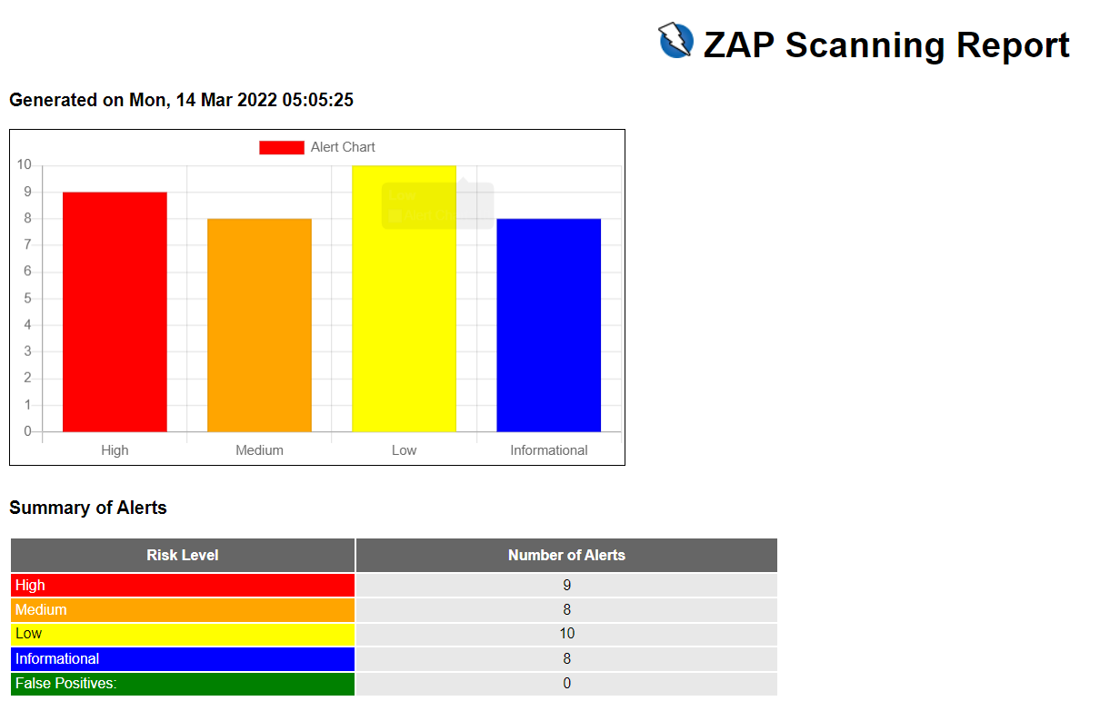
Report

Slide 4
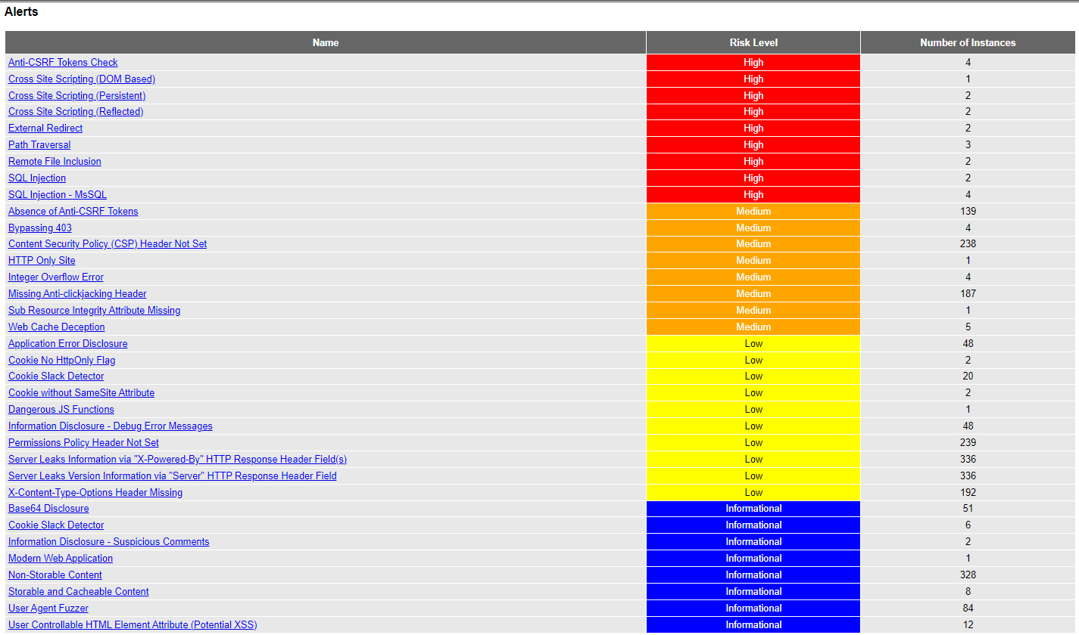
Report

Slide 5
Vulnerability
One of the vulnerabilities that has been exploited is SQL injection. As per OWASP’s definition SQL Injection is type of attack in which an attacker can input sql queries in an input field and from the client to the application.
Successful attack can read, modify and execute operations on the database.

Slide 6
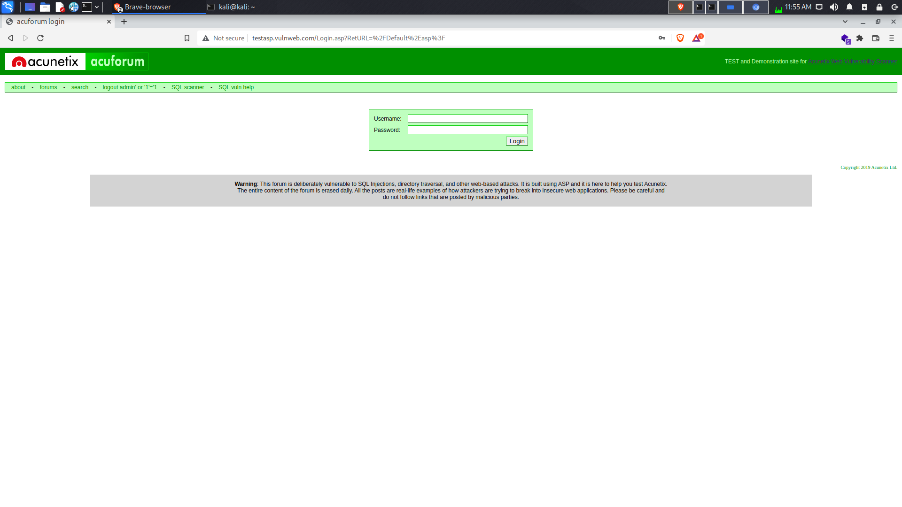
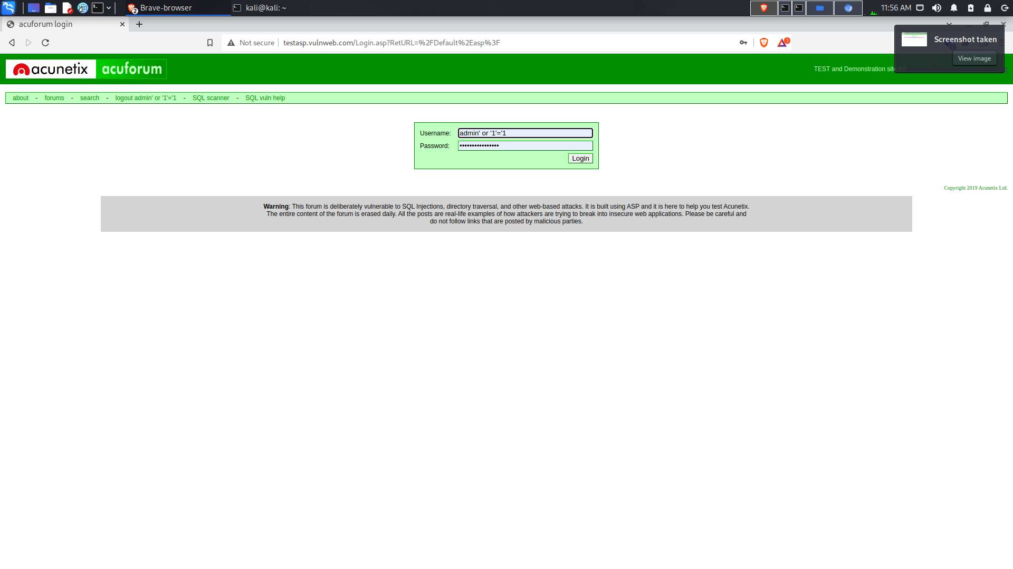
Proof of Concept

Slide 7
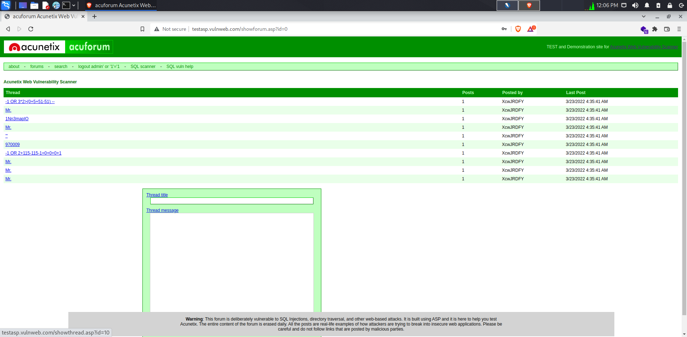
Proof of Concept
We are logged in the interface due to sql injection vulnerability.

Slide 8
Further Exploitation
I have used SQL map tool, which is used to exploit SQL vulnerabilities.
I have demonstrated the use of tool of SQL map, in which I would be exploiting the SQL injection vulnerabilties and get the information of the database.

Slide 9
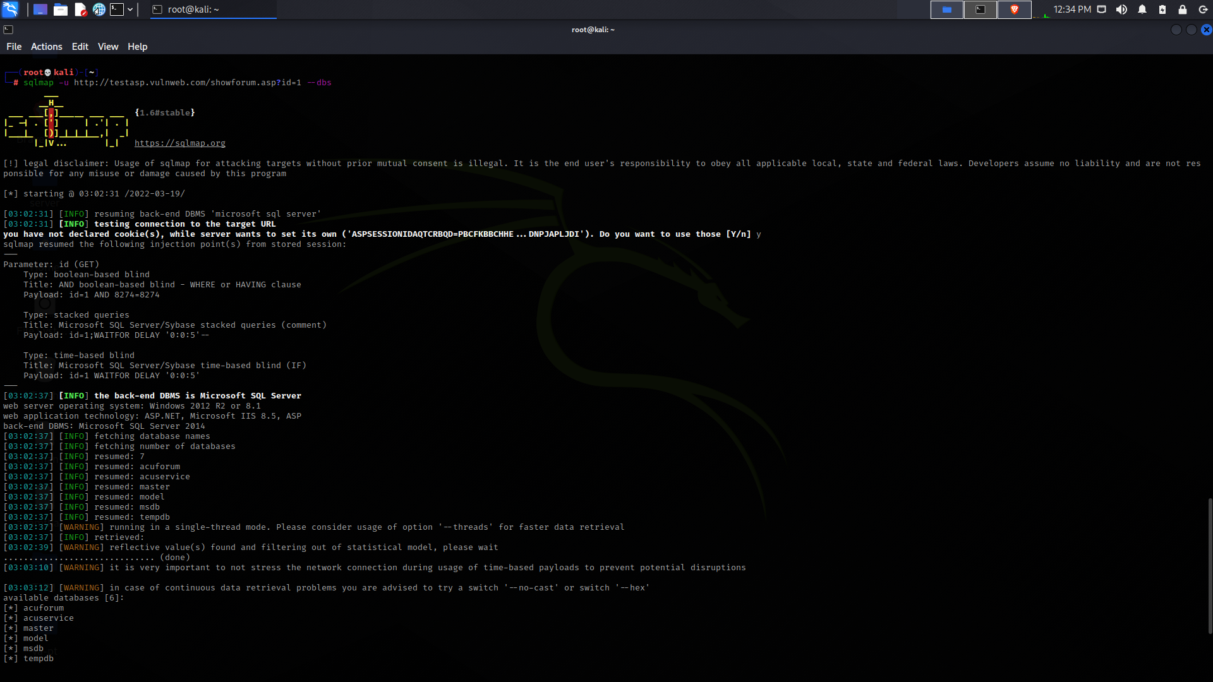
Proof of Concept

Slide 10
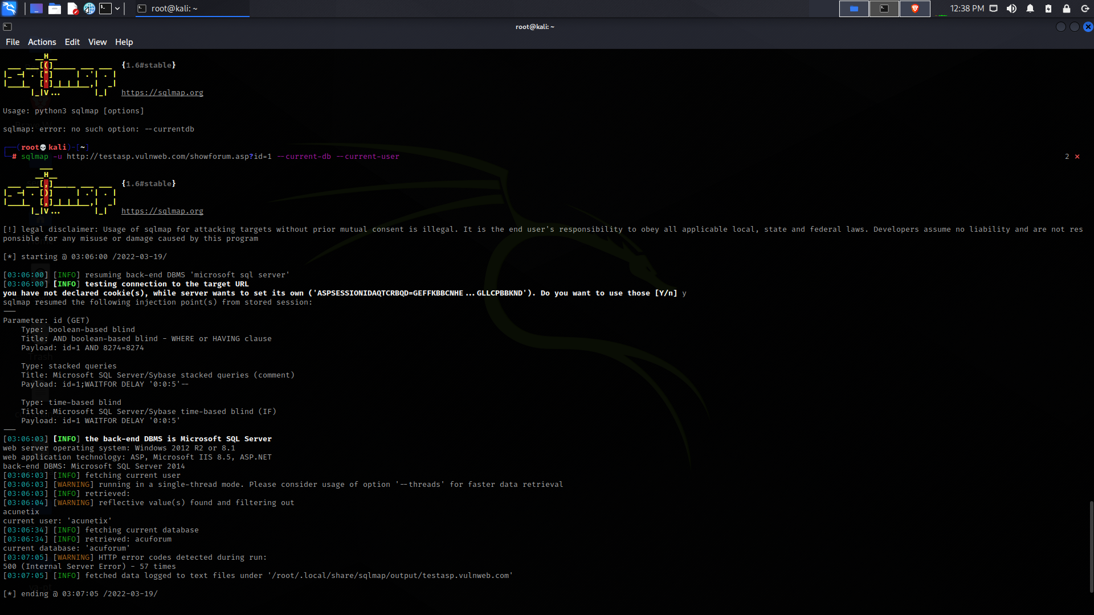
Proof of Concept

Slide 11
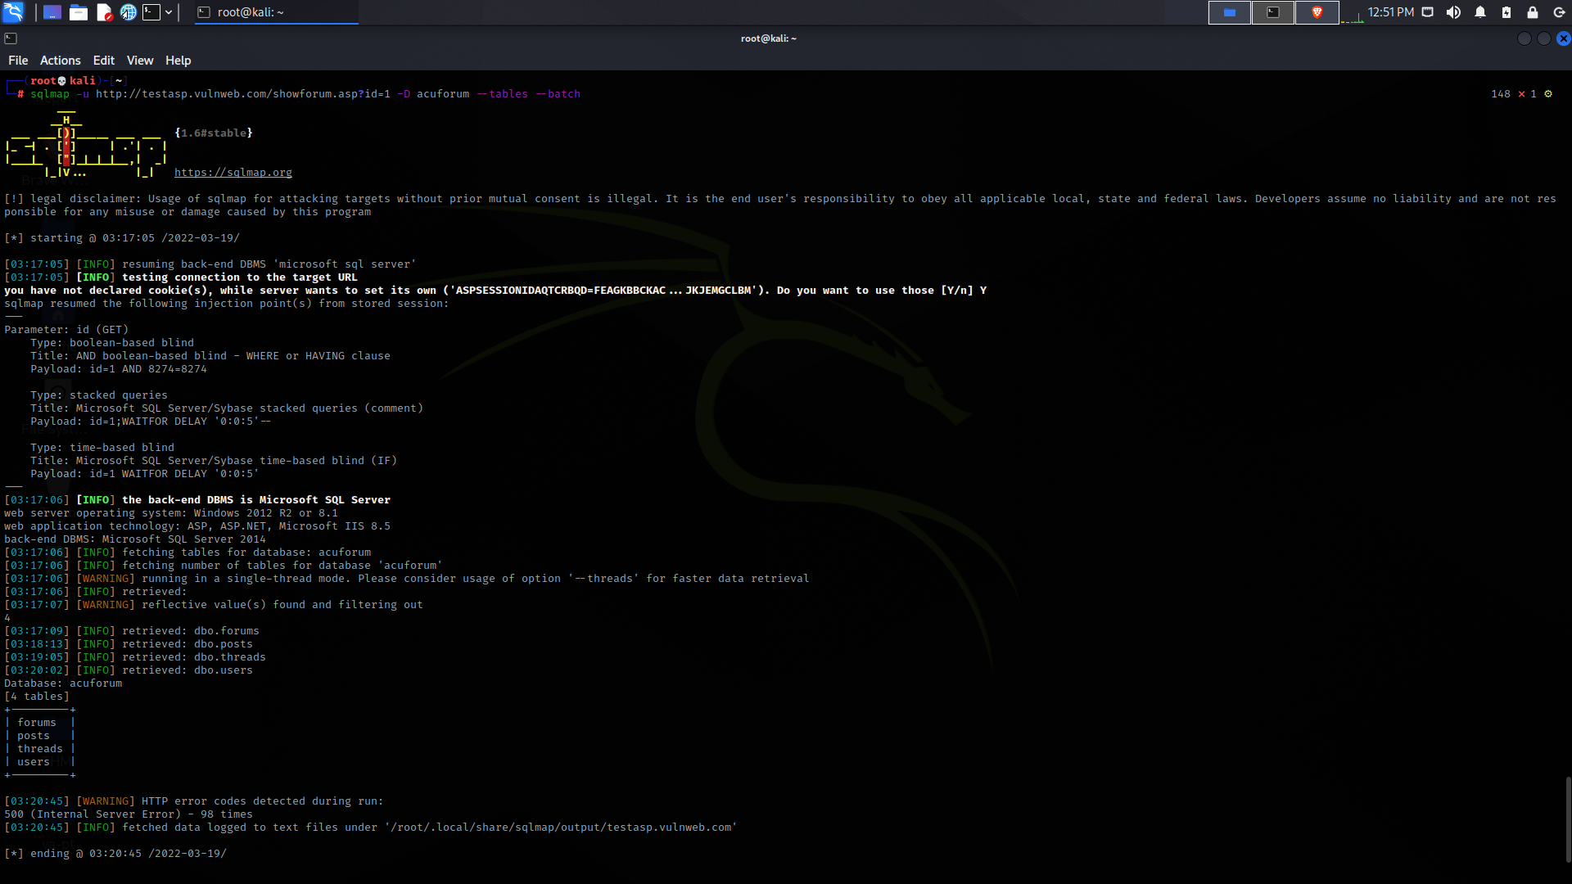
Proof of Concept

Slide 12
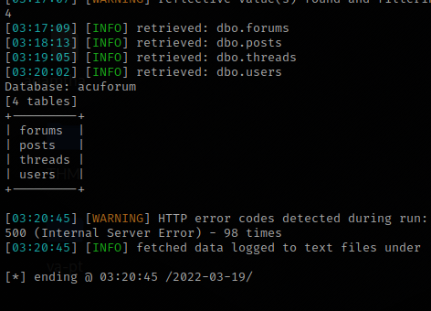
Proof of Concept
With help of SQL injection vulnerability and the tool of SQL map we are able to exploit the site and are able to retrieve information that should not be seen by the client.

Slide 13
Mitigation
The SQL Injection can be mitigated through SDLC and secure coding.
We can also provide input validation and sanitation the client side and the server side solutions. In server side sanitization and input validation ensures data input by the user in double or single quotes that could modify an SQL query.

Slide 14
Vulnerability
The site is also vulnerable to the Cross Site Scripting attacks also. Due to which an attacker can inject javascript code in the html code of the site and can harm the site and the users using it as well.
XSS attacks occur when an attacker uses a web application to send malicious code, generally in the form of a browser side script, to a different end user. Flaws that allow these attacks to succeed are quite widespread and occur anywhere a web application uses input from a user within the output it generates without validating or encoding it.

Slide 15
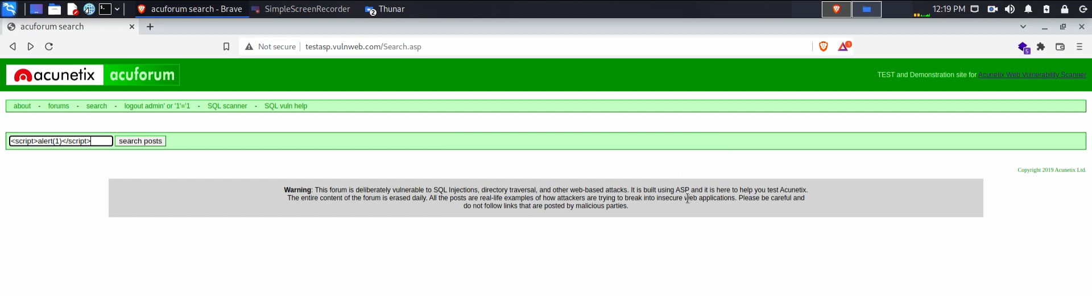
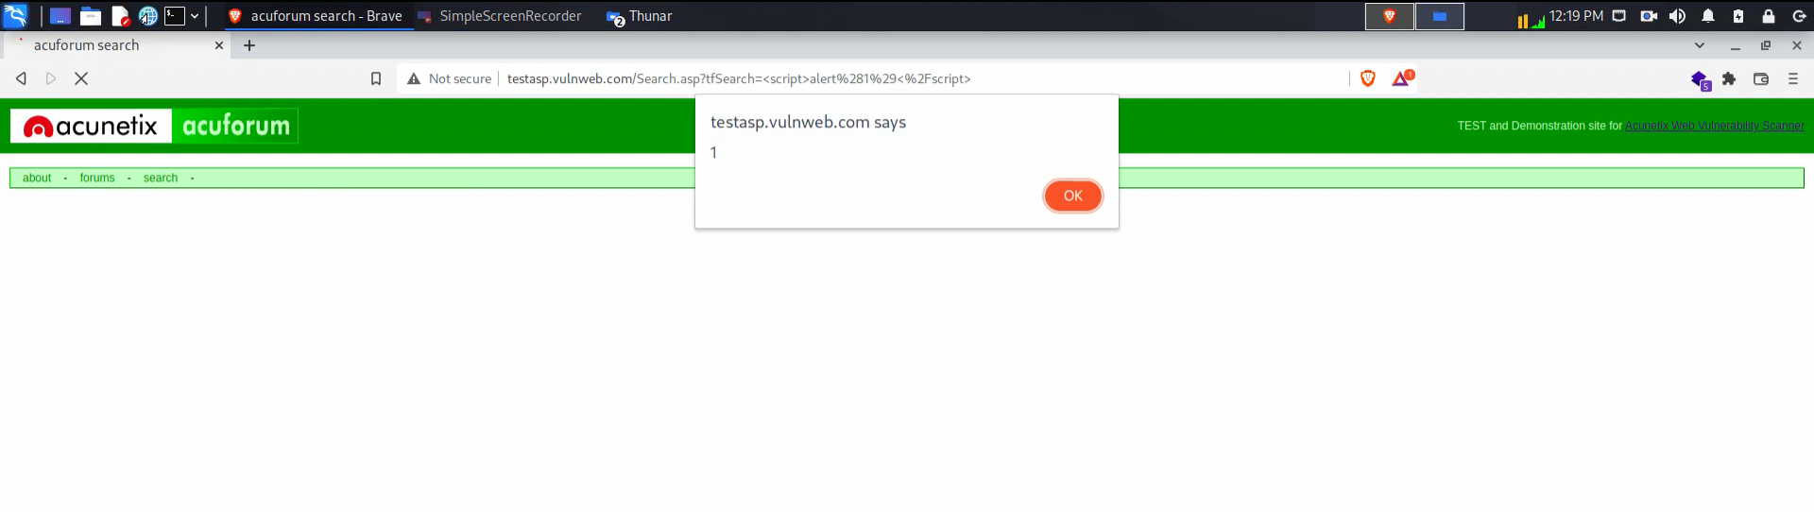
Proof of Concept

Slide 16
Mitigation
We can also provide input validation and sanitation the client side and the server side solutions. In server side sanitization and input validation ensures data input by the user in double or single quotes that could modify an XSS attack.

